Slide 1

United International University
Crime Analysis and Forecasting Integrating: Machine Learning
with Population Density and Economy
Course Title: Final Year Design Project-2.
Course Code: CSE 4000B.
Section: A1.
Instructor
Dr. Al-Sakib Khan Pathan
Professor at Department of CSE
United International University
Supervisor
Iftekharul Abedeen
Lecturer at Department of CSE
United International University

Slide 2






Group Member
Fatema
Sumiya Tabussum Dristy
Ahm Emramul Pasha
Raj Shekhar Karmaker
Suriya Najnine Nisamoni
Mahabub Alam Khan
ID: 011193055
ID: 011181237
ID: 011181243
ID: 011193149
ID: 011181131
ID: 011181216
Notes:
Insert a map of your country.

Slide 3

Introduction
In simple terms, crime is an unpredictable social disturbance.
Crime is divided into different categories such as
traffic crime,
fraud,
violent crime (attacker having weapons during robbery, criminal homicide, assaults, terrorism) , and
Cyber crime.
Notes:
Insert a picture of one of the geographic features of your country.

Slide 4
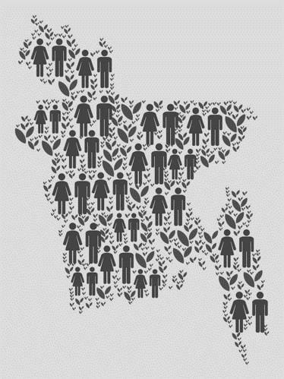
Introduction
We know very well population encompasses the entire collection of individuals, whether it constitutes nation as a whole or group of people sharing a common characteristics. So for population growth we have collected data form Worldometer
The findings reveal that Bangladesh's population nearly doubled from 1980 to 2015, making up about 2.2% of the world's population in 2013.
Notes:
Insert a picture of one of the geographic features of your country.

Slide 5
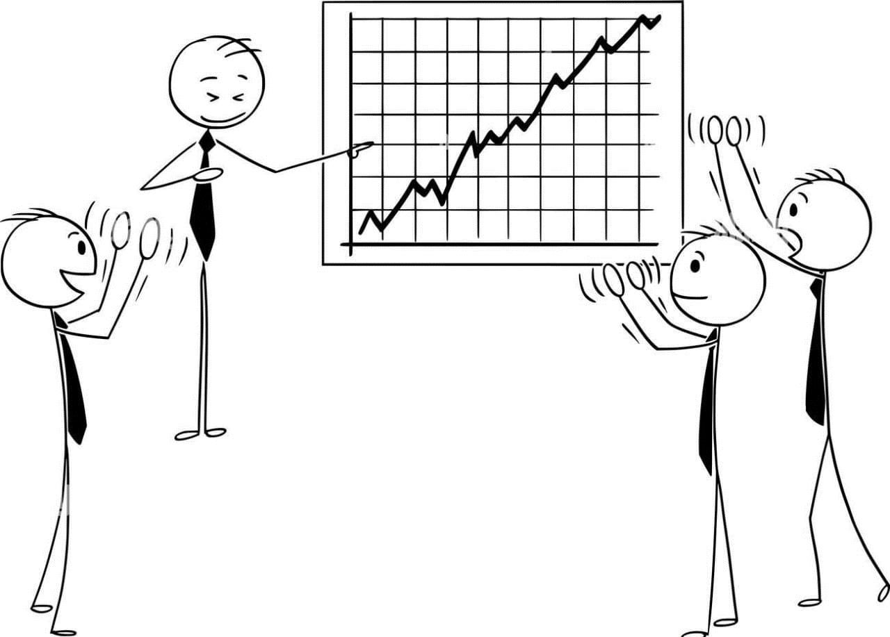
Introduction
Detotto and Otranto (2010), applying an autoregressive model, in which GDP growth is explained by past GDP and a crime proxy, to monthly crime data for Italy for 1979–2002, also find a small annualized real-GDP-growth reduction due to crime, with their estimates indicating cyclical components in the growth–crime relationship. The growth–crime relationship is found to be strongly negative in bad times.[6]
Notes:
Insert a picture of one of the geographic features of your country.

Slide 6


Motivation
Looking into the link between crime patterns and two important factors—population change and economic growth—to learn more about these topics and take a more responsible and knowledgeable approach to community safety.
Notes:
Insert a picture of one of the geographic features of your country.

Slide 7
Objectives
Providing law enforcement agencies with modern instruments to actively prevent crime, using machine learning, population density, and economic analysis to improve public safety.
Giving developing countries useful information about crime patterns and how they are linked to population and economic growth. This will help them make smart decisions about community development and safety.
Notes:
Insert a picture of one of the geographic features of your country.

Slide 8

Existing Work
The K-nearest neighbor algorithm (K-NN) is a classification algorithm used for classifying the objects.
The decision tree is used to detect suspicious mails and provide accuracy in classifying emails
Support vector machine (SVM) is a supervised machine learning algorithm
The Naïve Bayes Belief network is a probabilistic model that is used for the classification
K-mean clustering is used to partition the data into k- clusters based on their mean.
Notes:
Insert a picture of one of the geographic features of your country.

Slide 9

Literature Review
We have studied several number of papers. 4 of them are shown here and other papers are described on our report.
Notes:
Insert a picture of one of the geographic features of your country.

Slide 10
Literature Review
Name
Published Year
Crime Prediction using Machine Learning [1]
15th February, 2024
Crime Against Women and Girls in Indian states:
Analysis, Visualization and Prediction [2]
26th December, 2023
Machine Learning-based Soft Computing Regression Analysis Approach for
Crime Data Prediction [3]
January, 2022
Bangladesh Crime Reports Analysis and Prediction [4]
August, 2021
Notes:
Insert a picture of one of the geographic features of your country.

Slide 11
Literature Review
Dataset
Method
Performance Evaluation
Indian crime data (2001-2016) includes over 500 entries. Focus on women, children, and IPC cases.
Statistical and machine learning models (K-NN, Naive Bayes, Regression) analyze crime patterns using demographic, economic, social, victim, and geographic variables.
“Indian Crime Analysis” predicts crime ratios (2017-2020) with K-NN accuracy, identifying trend-changing years.
Data from the National Commission for Women (NCW) is categorized into nine crime types across Indian states.
The study analyzes real-life data on crimes against women in India using statistical tests and visualization techniques.
Hot states” with high crime rates include Uttar Pradesh, Delhi, Haryana, and Rajasthan.
Notes:
Insert a picture of one of the geographic features of your country.

Slide 12
Literature Review
Dataset
Method
Performance Evaluation
The study used district-wise spatial-temporal crime data from 2001 to 2012, collected from the official website of the National Crime Records Bureau (NCRB)5. The data included various types of crimes such as murder, rape, kidnapping, abduction, riots, and more, across different regions and states in India6.
The paper proposes a machine learning-based soft computing regression analysis approach for predicting crime data in India1. It utilizes various regression algorithms like Simple Linear Regression (SLR), Multiple Linear Regression (MLR), Decision Tree Regression (DTR), Support Vector Regression (SVR), and Random Forest Regression (RFR) to build predictive models23..
The Random Forest Regression (RFR) model yielded the best fit for region-wise total Indian Penal Code (IPC) crime prediction with an adjusted R squared value of 0.9631551 and a Mean Absolute Percentage Error (MAPE) of 0.20274374. For region-wise theft crime count prediction, the RFR model also performed best with an adjusted R squared value of 0.966604 and a MAPE of 0.16571.
Crime statistics from 2010 to 2018 are collected from the Bangladesh Police website. ACLED data provides event types and geolocations.
Machine learning algorithms analyze crime patterns in Bangladesh using data from the Bangladesh Police website and ACLED. Decision Trees, Random Forest, and MLP models are used.
Successful crime trend predictions for 2019 using the Bangladesh Police dataset. Random Forest performs best for ACLED predictions in 2021. Law enforcement can benefit from this study.
Notes:
Insert a picture of one of the geographic features of your country.

Slide 13

Dataset
Our work is crime analysis based on two factor Economical Growth and Population
For crime we collect our data from Bangladesh police website and ACLED.[7]
For population we collect our data from Worldmeter website[8]. For GDP we collect our Data from World bank.[11]
Notes:
Insert a picture of one of the geographic features of your country.

Slide 14

Dataset
We gathered historical crime data from the official website of the Bangladesh Police from 2010-2019. In this dataset 2019 data is incomplete. Because it’s updated in the middle of the year and never update again. So we ignore 2019 sample or instance.
Dacoity,
Robbery,
Murder,
Speedy Trial,
Kidnapping,
Arms act,
Theft,
Narcotics,
Police Assault etc.
Notes:
Insert a picture of one of the geographic features of your country.

Slide 15

Dataset
In ACLED website we found data from 2001 to 2020 and there are approximately 30,000 sample. These samples are in different location and different event type.
Notes:
Insert a picture of one of the geographic features of your country.

Slide 16

Dataset
After collecting the data we start pre-processing. For this we ignore the unnecessary attributes & blank cells etc.
All our data is uploaded in the Github.[10]
https://github.com/KhanStack/Final-Year-Design-Project
Notes:
Insert a picture of one of the geographic features of your country.

Slide 17
System Architecture
Check Model Accuracy
If not good enough
Dataset
Pre-Processing
Training Set
Learning Algorithm
Final Model
Sampling
Testing Set
Model Evaluation
Fig. 1. Diagram

Slide 18

Proposal
We are proposing
Regression Technique. A best way to identify trend in a dataset.
After feed proper dataset our models gives us result and then we compare them.
We are going to see if there any correlation between crime and Economical Growth and Population.
Notes:
Insert a picture of one of the geographic features of your country.

Slide 19

Well that’s a lot now what do we achieve?

Slide 20
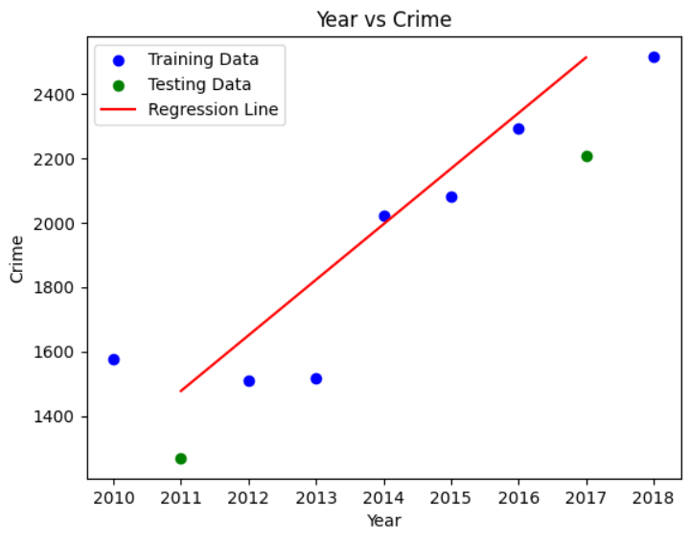
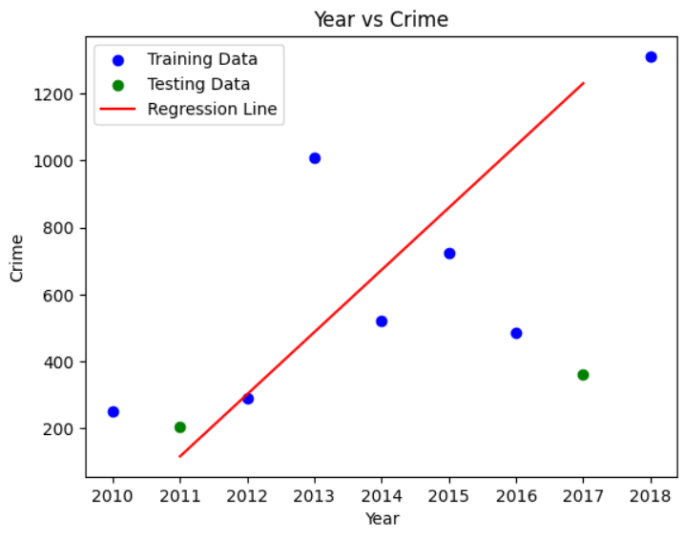
Let’s Discuss Result with Visual Representation and trend
Bangladesh Police Website
Crime Rate Has Been Increasing:
Fig.1: Arms Act
Fig.2: Explosives

Slide 21
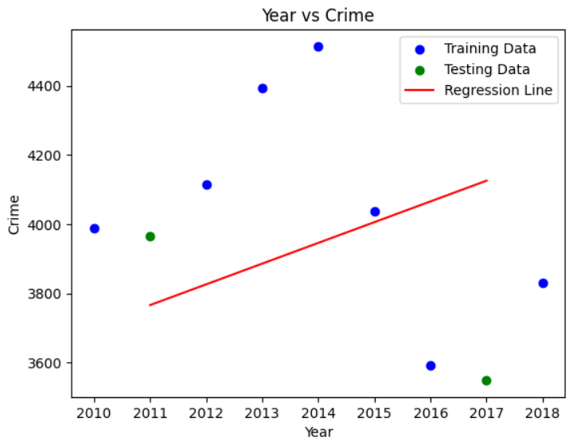
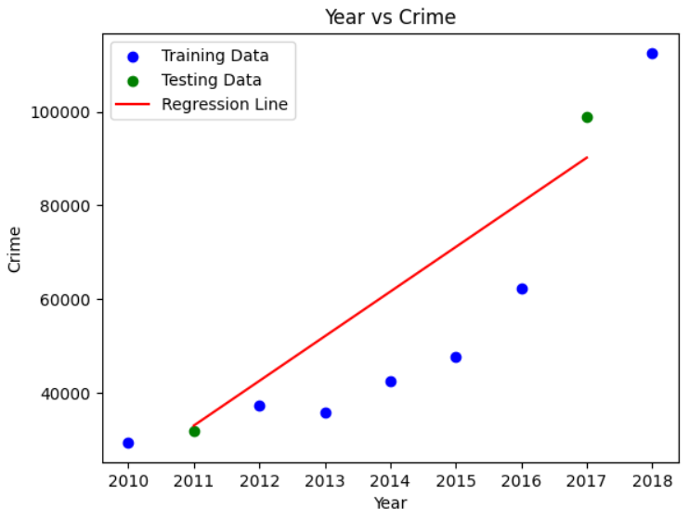
Bangladesh Police Website
Crime Rate Has Been Increasing:
Fig.3: Murder
Fig.4: Narcotics

Slide 22
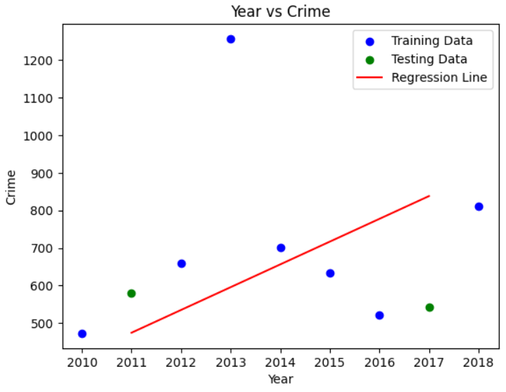
Bangladesh Police Website
Crime Rate Has Been Increasing:
Fig.5: Police Assault

Slide 23
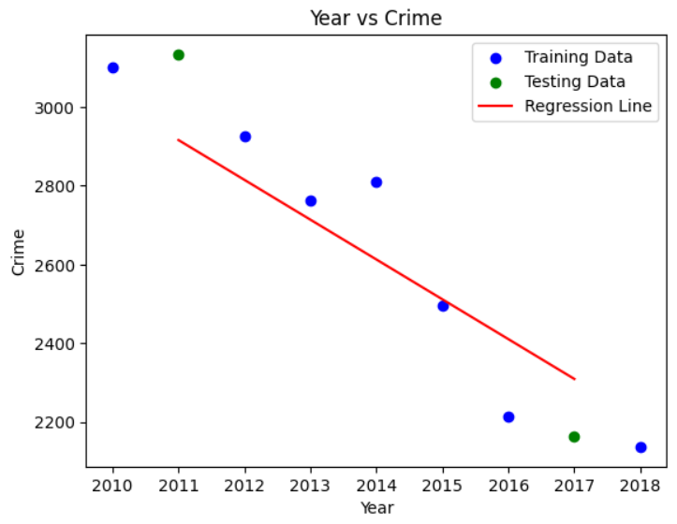
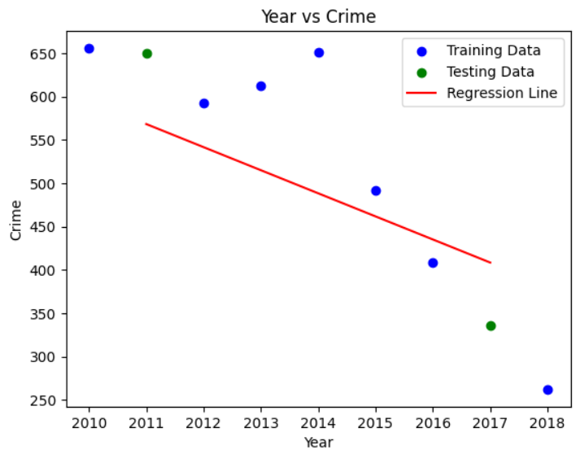
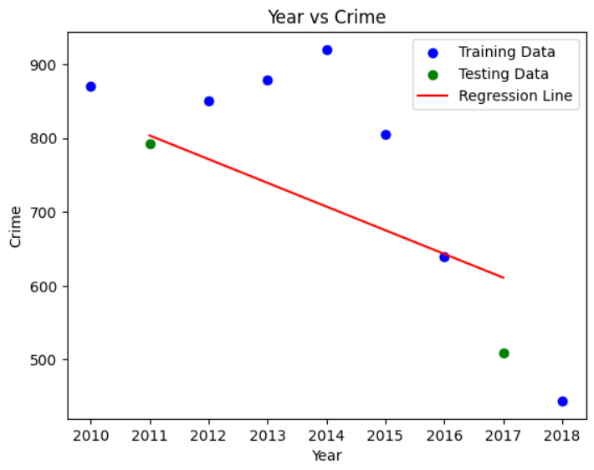
Bangladesh Police Website
Crime Rate Has Been Decreasing :
Fig.6: Burglary
Fig.7: Dacoity
Fig.8: Kidnapping

Slide 24
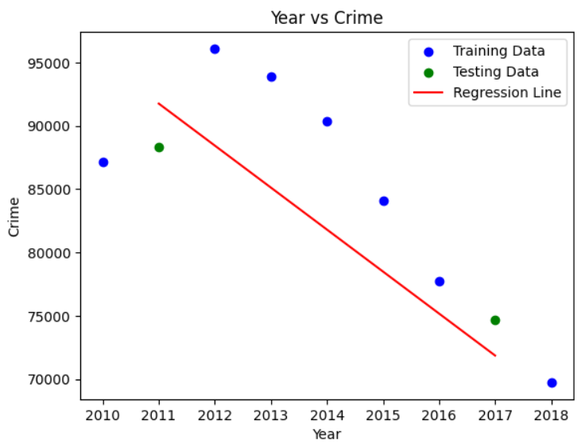
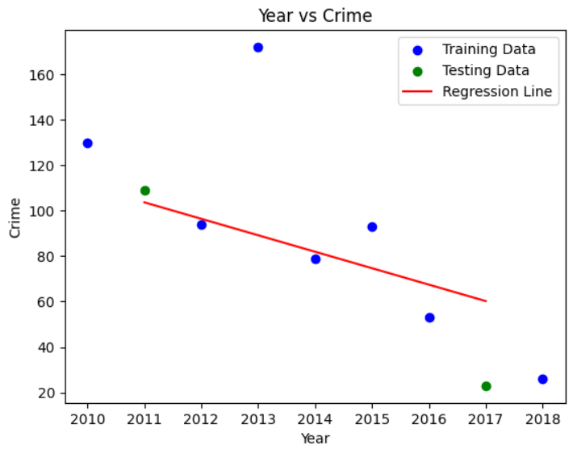
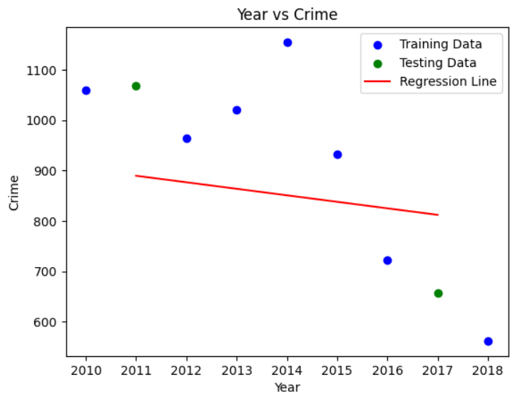
Bangladesh Police Website
Crime Rate Has Been Decreasing :
Fig.9: Other Cases
Fig.10: Riot
Fig.11: Robbery

Slide 25
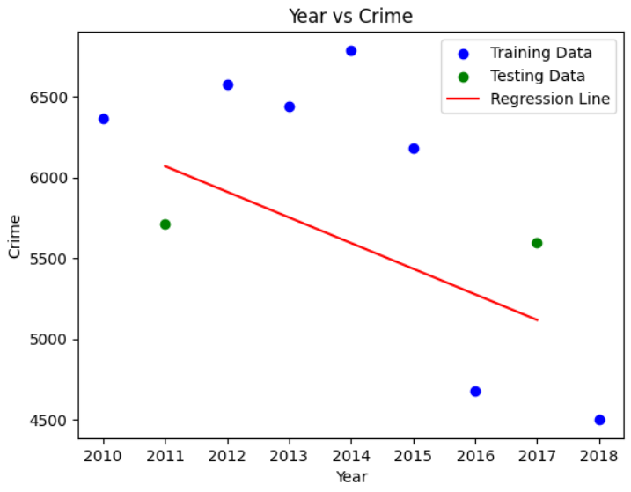
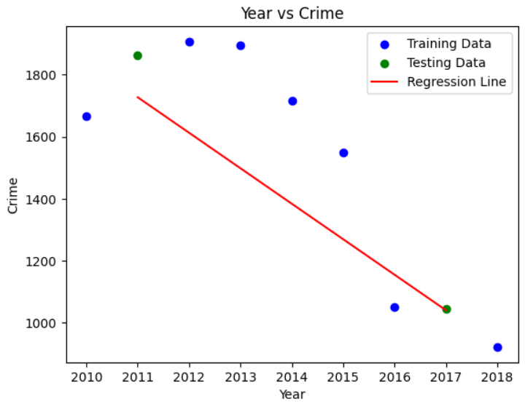
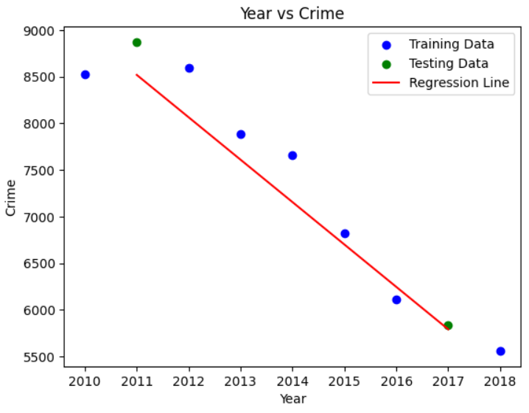
Bangladesh Police Website
Crime Rate Has Been Decreasing :
Fig.12: Smuggling
Fig.13: Speedy Trial
Fig.14: Theft

Slide 26
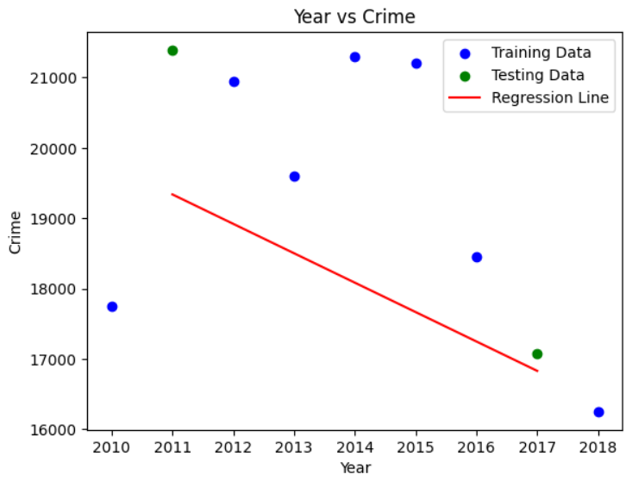
Bangladesh Police Website
Crime Rate Has Been Decreasing :
Fig.15: Woman and Child Repression

Slide 27
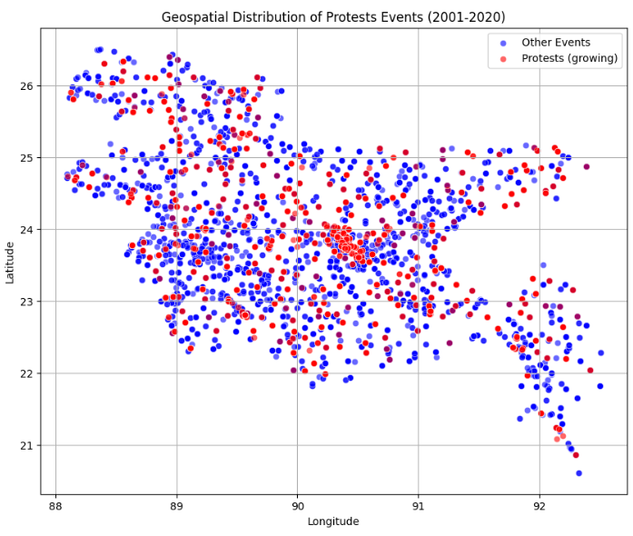
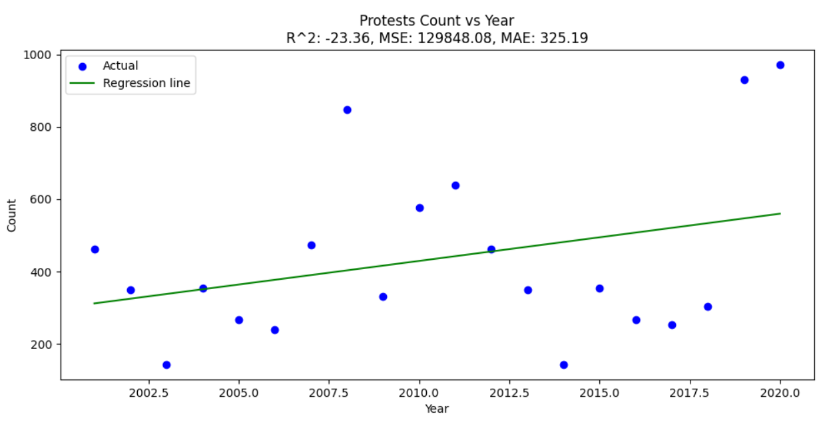
ACLED Dataset Analysis
Increasing event:
Fig.16.1: Protest
Fig.16.2: Protest Event

Slide 28
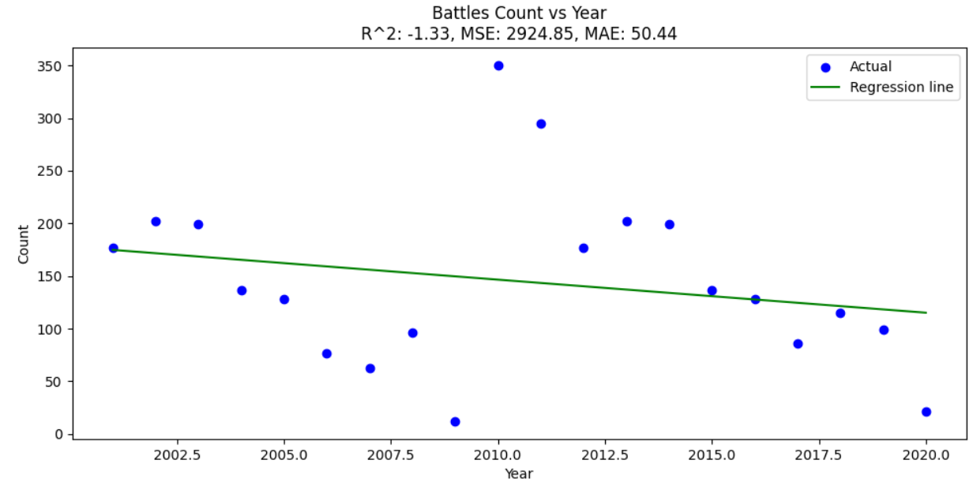
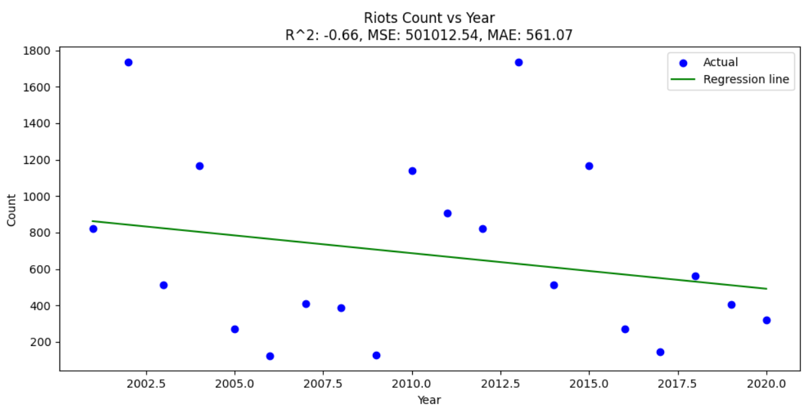
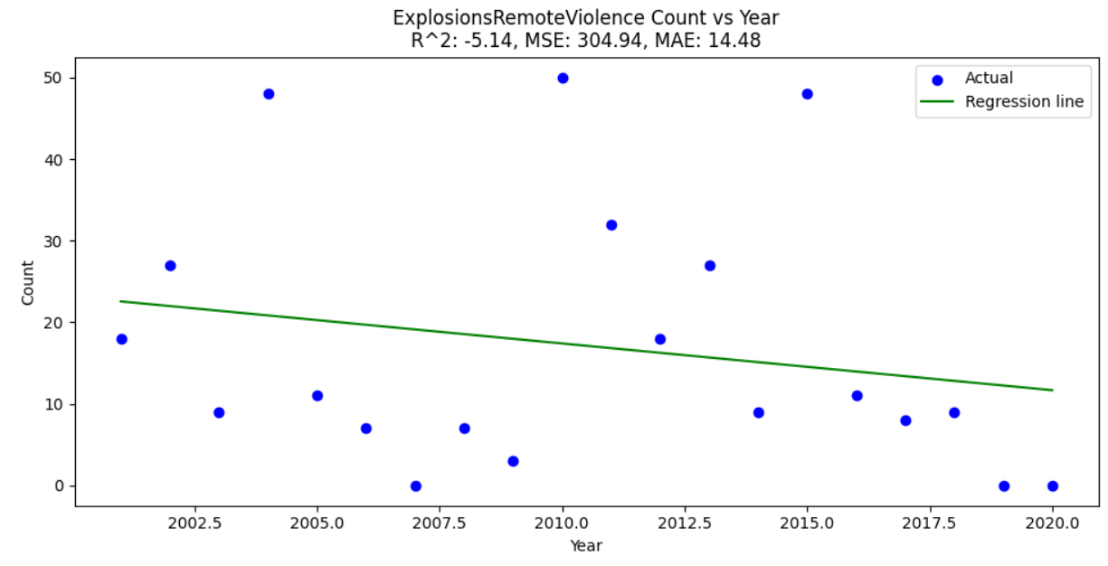
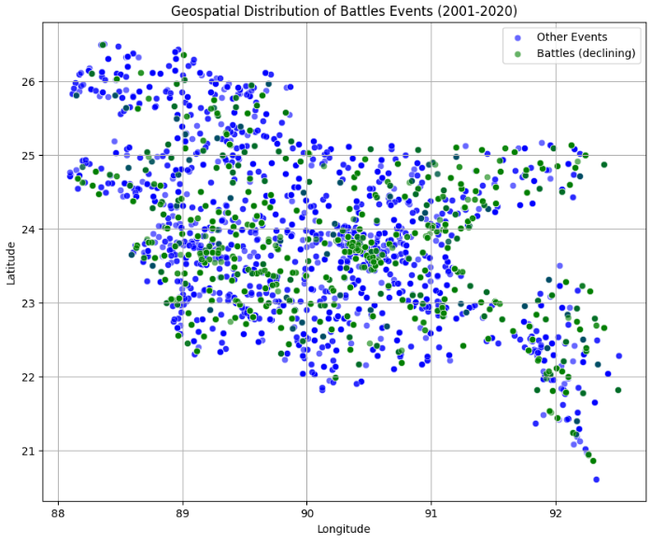
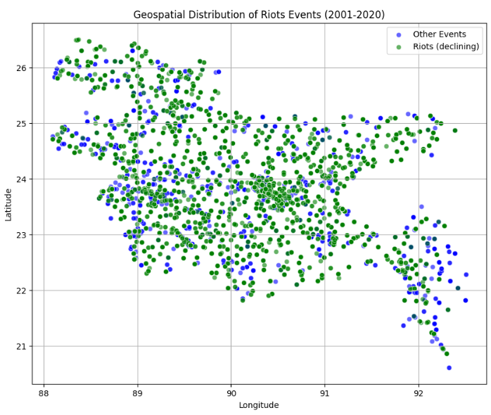
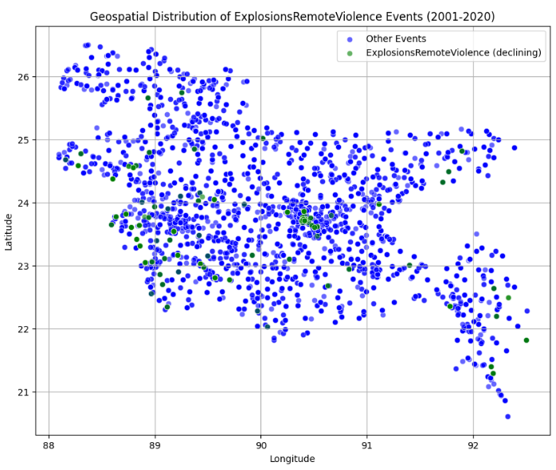
ACLED Dataset Analysis
Decreasing events:
Fig.17.1: Battle
Fig.18.1: Riot
Fig.19.1: Explosion Remote Violence
Fig.17.2: Battle Event
Fig.18.2: Riot Event
Fig.19.2: Explosion Remote Violence Event

Slide 29
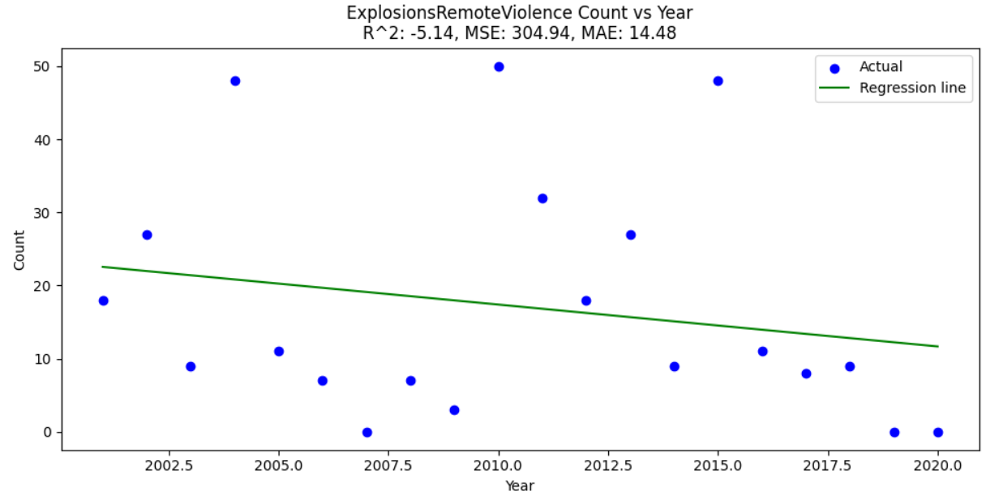
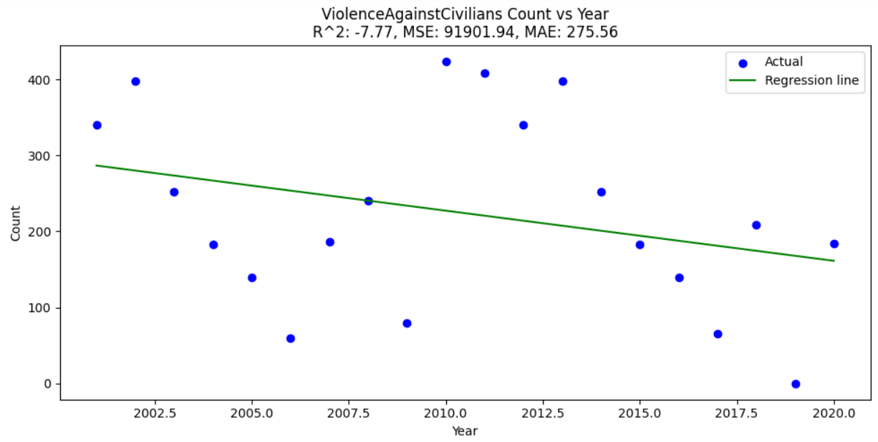
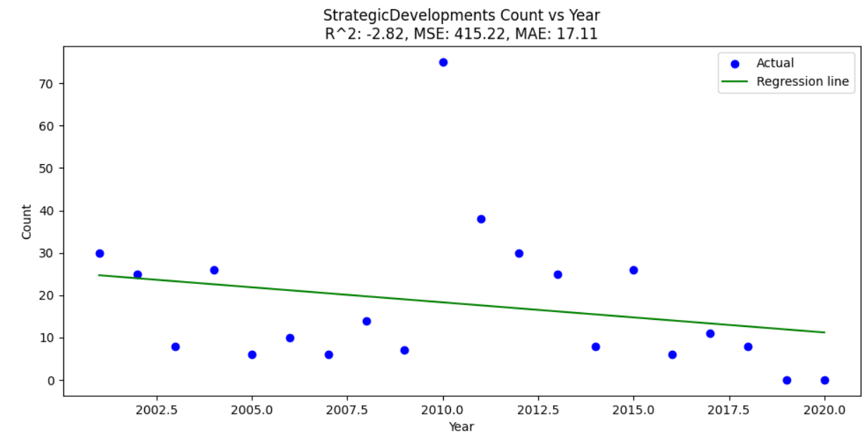
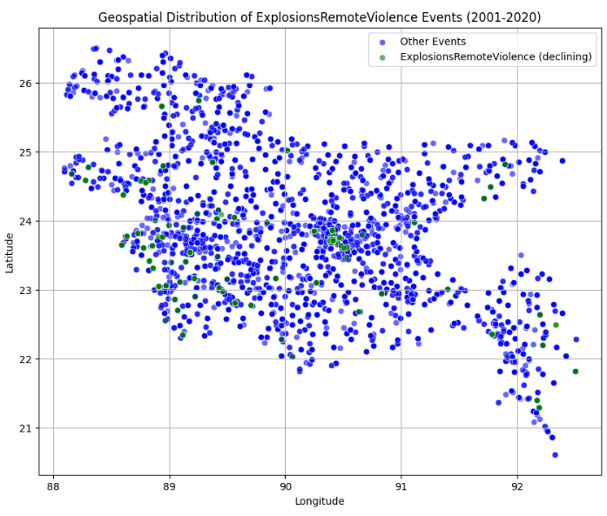
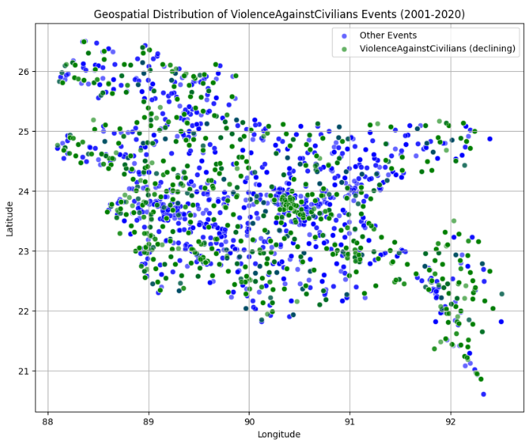

ACLED Dataset Analysis
Decreasing events:
Fig.17.1: Remote Violence
Fig.18.1: Violence Against Civilians
Fig.19.1: Strategic Development
Fig.17.2: Remote Violence Event
Fig.18.2: Violence Against Civilians Event
Fig.19.2: Strategic Development Event

Slide 30

Complex Engineering: Graduate Attributes
Engineering Knowledge
Problem Analysis
Design
Modern Tools
Investigation
Engineers and Society
Environment and Sustainability
Ethics
Team Work
Communication
Project Management and Finance
Lifelong learning

Slide 31

Conclusion
Machine learning, population density, and economic analysis can be used to make the public safer by giving law enforcement agencies modern tools to actively stop crime.
The regression analysis of both datasets reveals substantial trends and patterns in criminal
and violent activity during the study periods. The findings show that economic
development and increasing literacy rates are critical in reducing financially motivated
crimes. Conversely, the increase in protests demonstrates a more aware and active population
fighting for their rights. These findings can help policymakers and law enforcement
authorities focus on regions that need attention and promote a safer, more fair society.

Slide 32
reference
S Sridharan, N Srish, S Vigneswaran, and P Santhi. Crime prediction using machine learning. EAI Endorsed Transactions on Internet of Things, 10, 2024.
Aggarwal, S., Aggarwal, G. and Bansal, M., Crime Against Women and Girls in Indian states: Analysis, Visualization and Prediction.
Aziz, R.M., Hussain, A., Sharma, P. and Kumar, P., 2022. Machine learning-based soft computing regression analysis approach for crime data prediction. Karbala International Journal of Modern Science, 8(1), pp.1-19.
Rahman, Md Pavel, et al. "Bangladesh crime reports analysis and prediction." 2021 International Conference on Software Engineering & Computer Systems and 4th International Conference on Computational Science and Information Management (ICSECS-ICOCSIM). IEEE, 2021.
Awal, Md Abdul, et al. "Using linear regression to forecast future trends in crime of Bangladesh." 2016 5th international conference on informatics, electronics and vision (ICIEV). IEEE, 2016.
Eleftherios Goulas, Athina Zervoyianni, Economic Modeling. Volume 49, September 2015, Pages 286-295. Accepted 27 April 2015
Police.gov.bd, PeopleNTech, 2023, www.police.gov.bd/en/crime_statistic/year/2010.
Worldometer. “Bangladesh Population (2019) - Worldometers.” Worldometers.info, 2023, www.worldometers.info/world-population/bangladesh-population/.
Li, Xingan, et al. "GDP growth vs. criminal phenomena: data mining of Japan 1926–2013." AI & society 33 (2018): 261-274.
https://github.com/KhanStack/Final-Year-Design-Project
World Bank. “GDP Growth (Annual %) - Bangladesh | Data.” Data.worldbank.org, World Bank, June 2020, data.worldbank.org/indicator/NY.GDP.MKTP.KD.ZG?locations=BD.
Notes:
Insert a picture illustrating a season in your country.

Slide 33
Thank You.

